Slide 1
Setting up with RStudio Cloud: 7 Steps
Jim Duggan

Slide 2
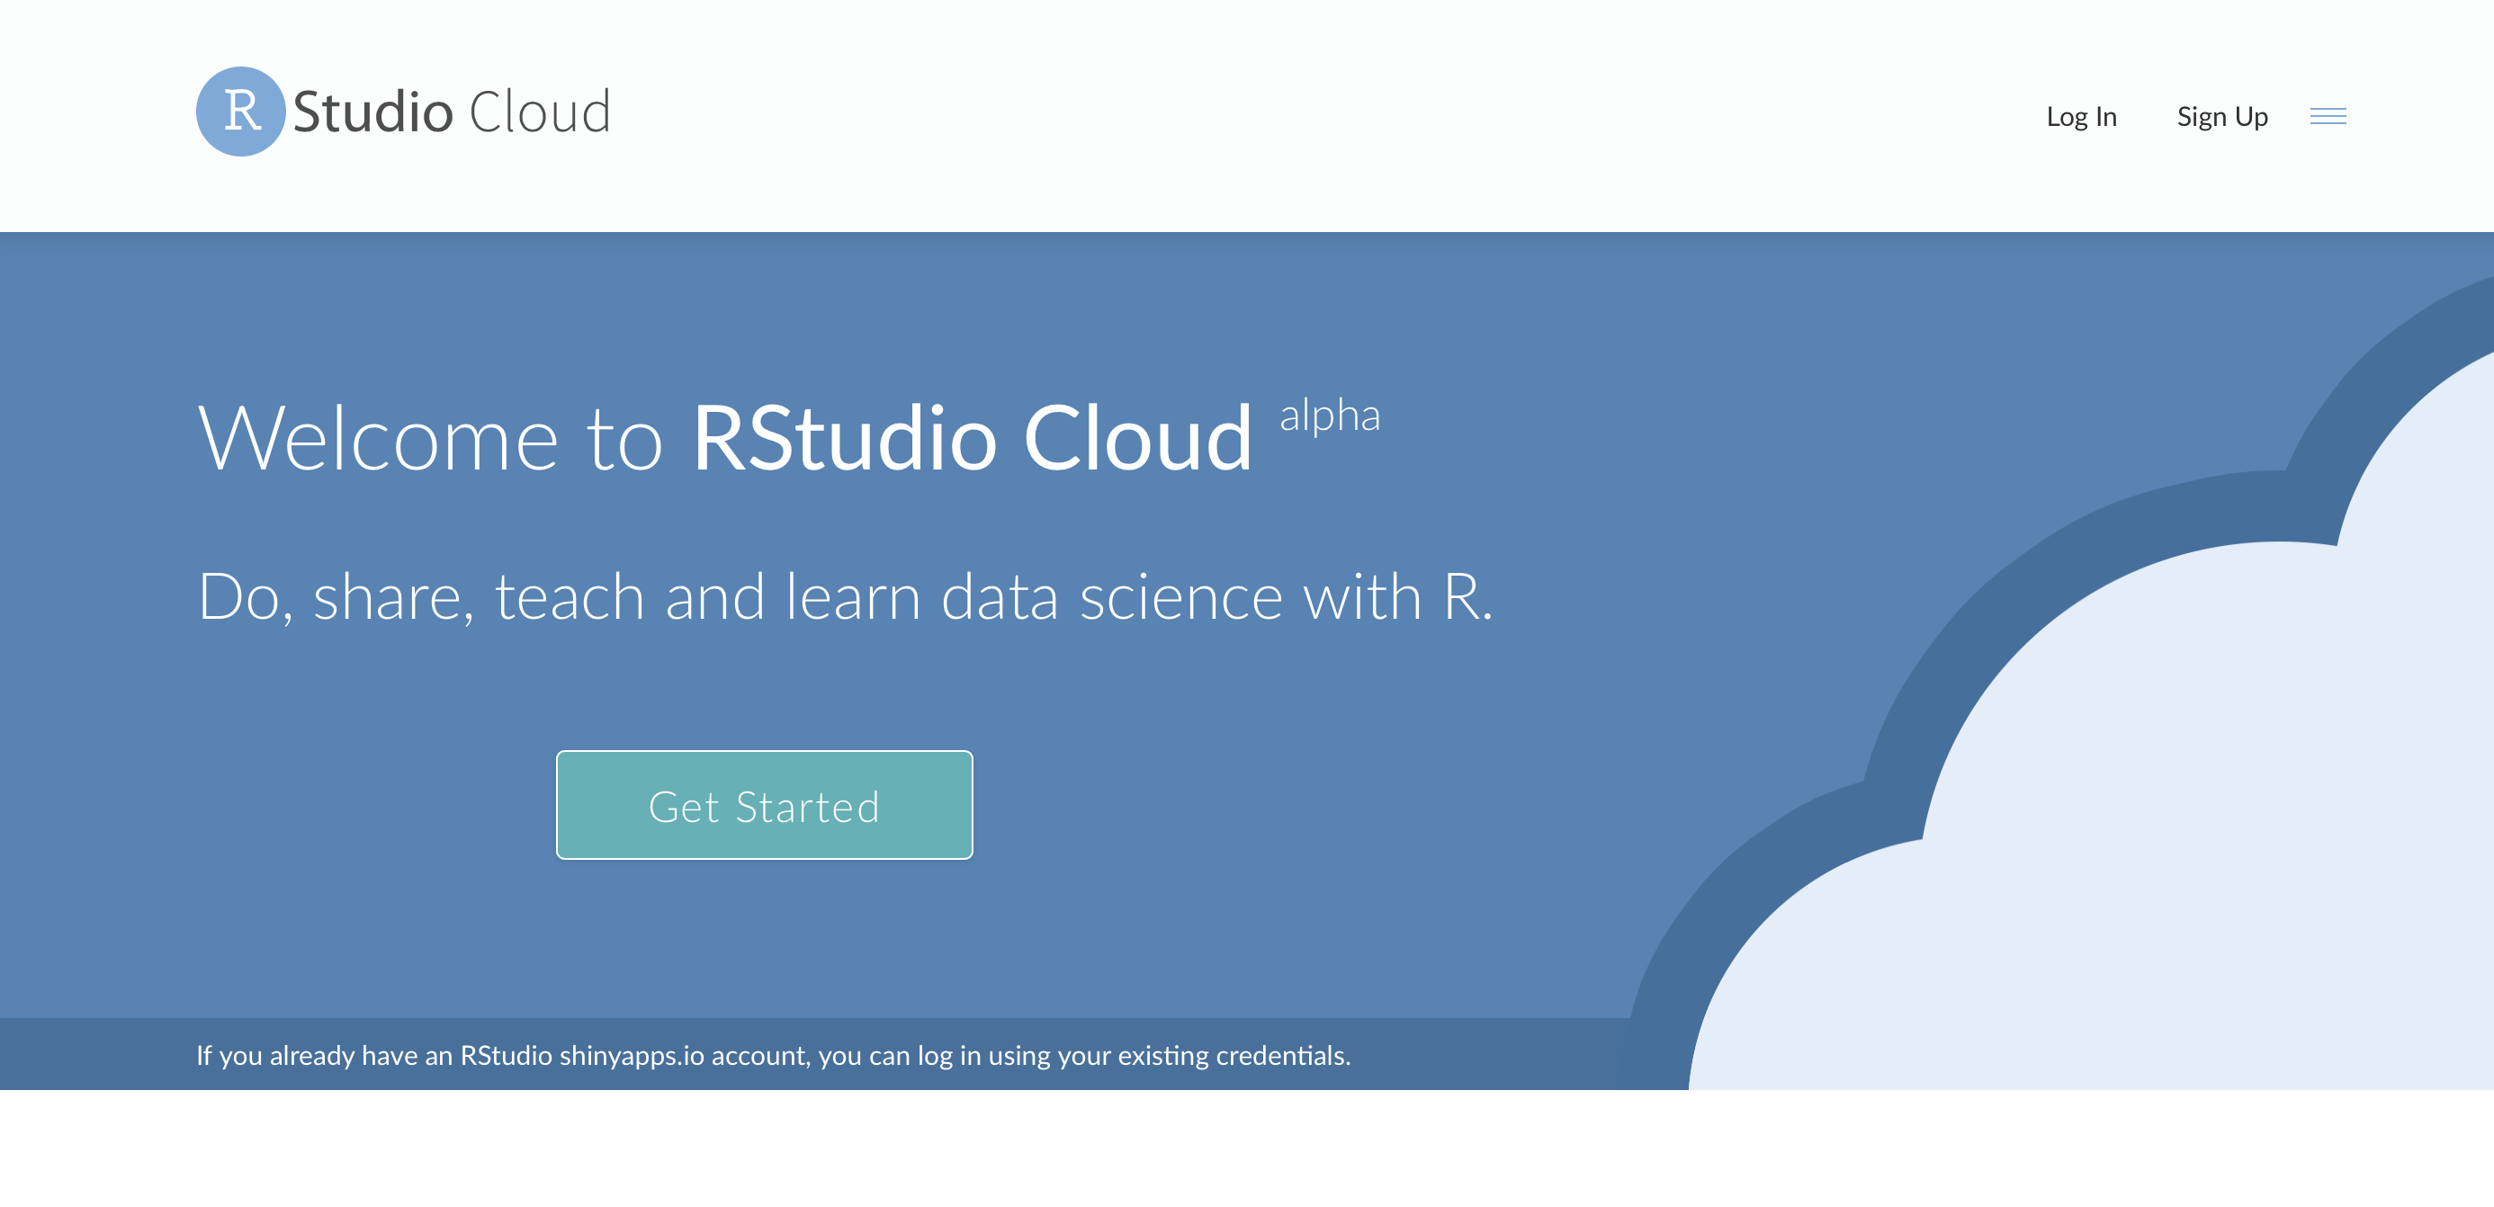
(1) Create your account on https://rstudio.cloud and login

Slide 3
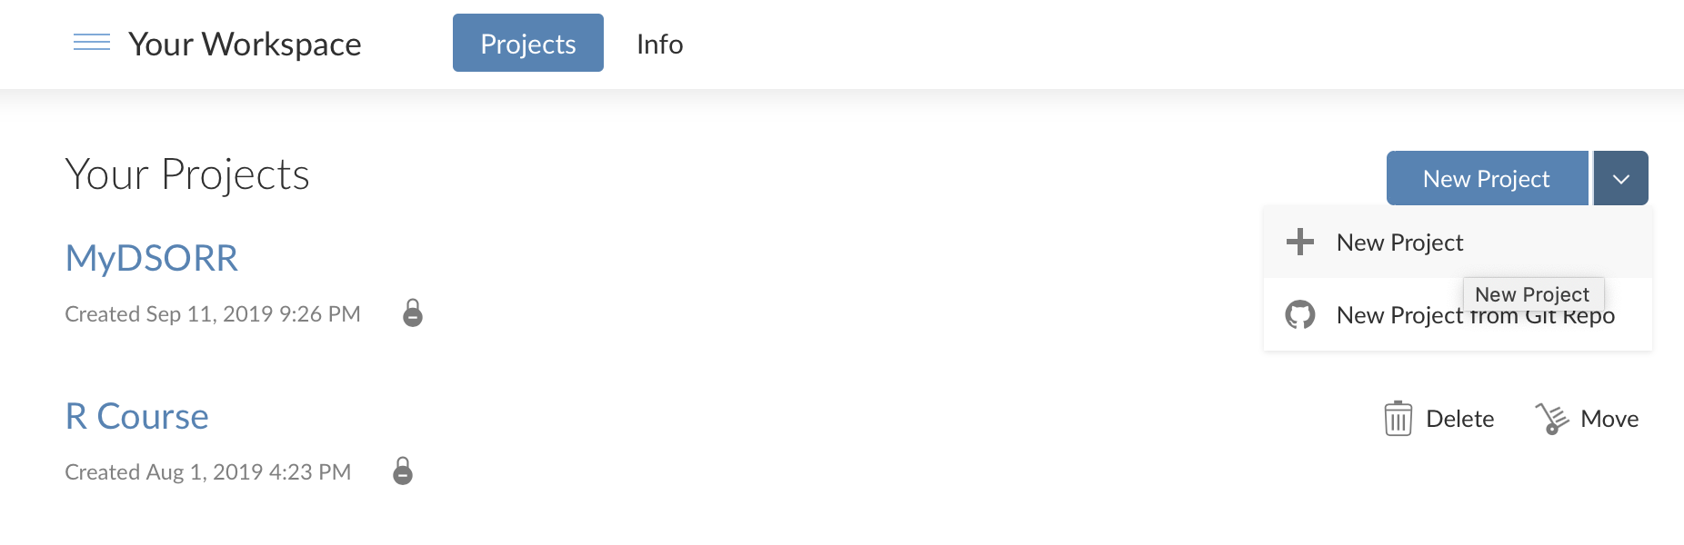
(2) In your workspace, create a project

Slide 4
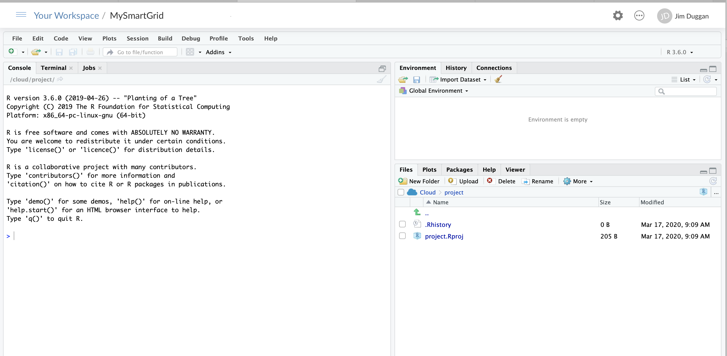
(3) Name the project (e.g. MySmartGrid)

Slide 5
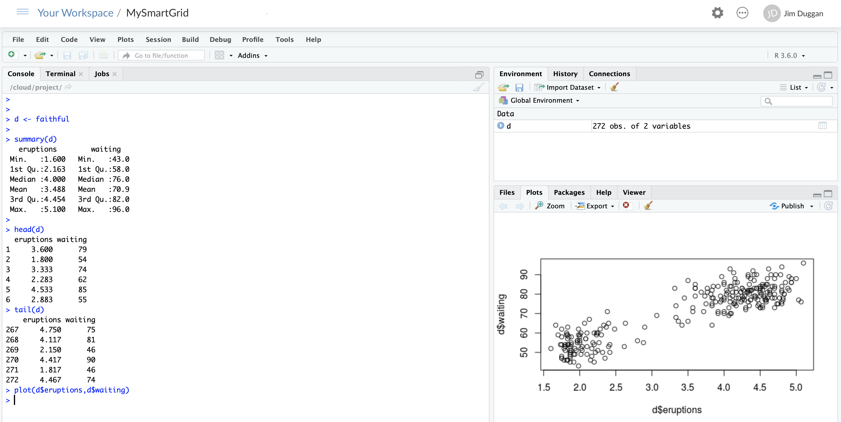
(4) Run some R code in Console

Slide 6
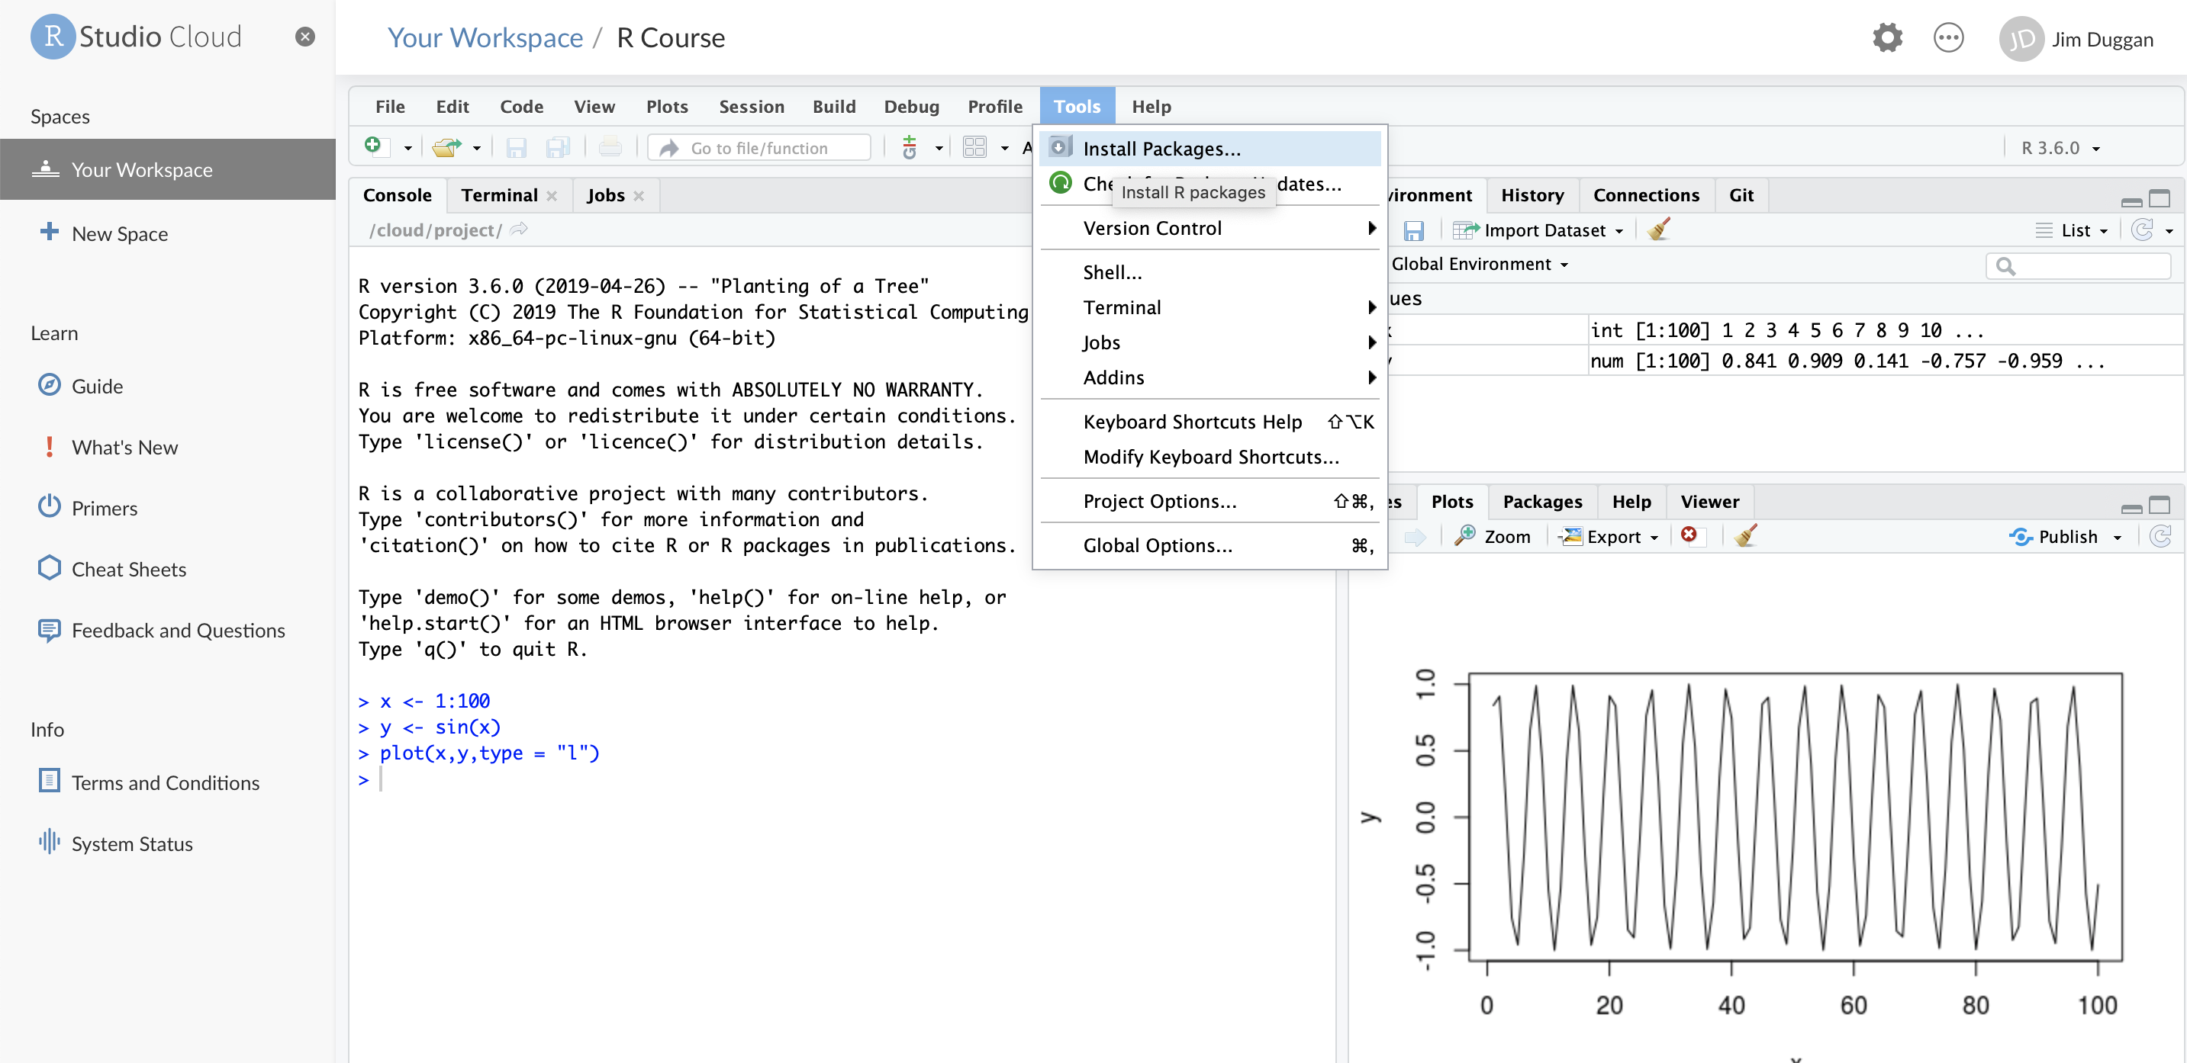
(5) Install required packages

Slide 7
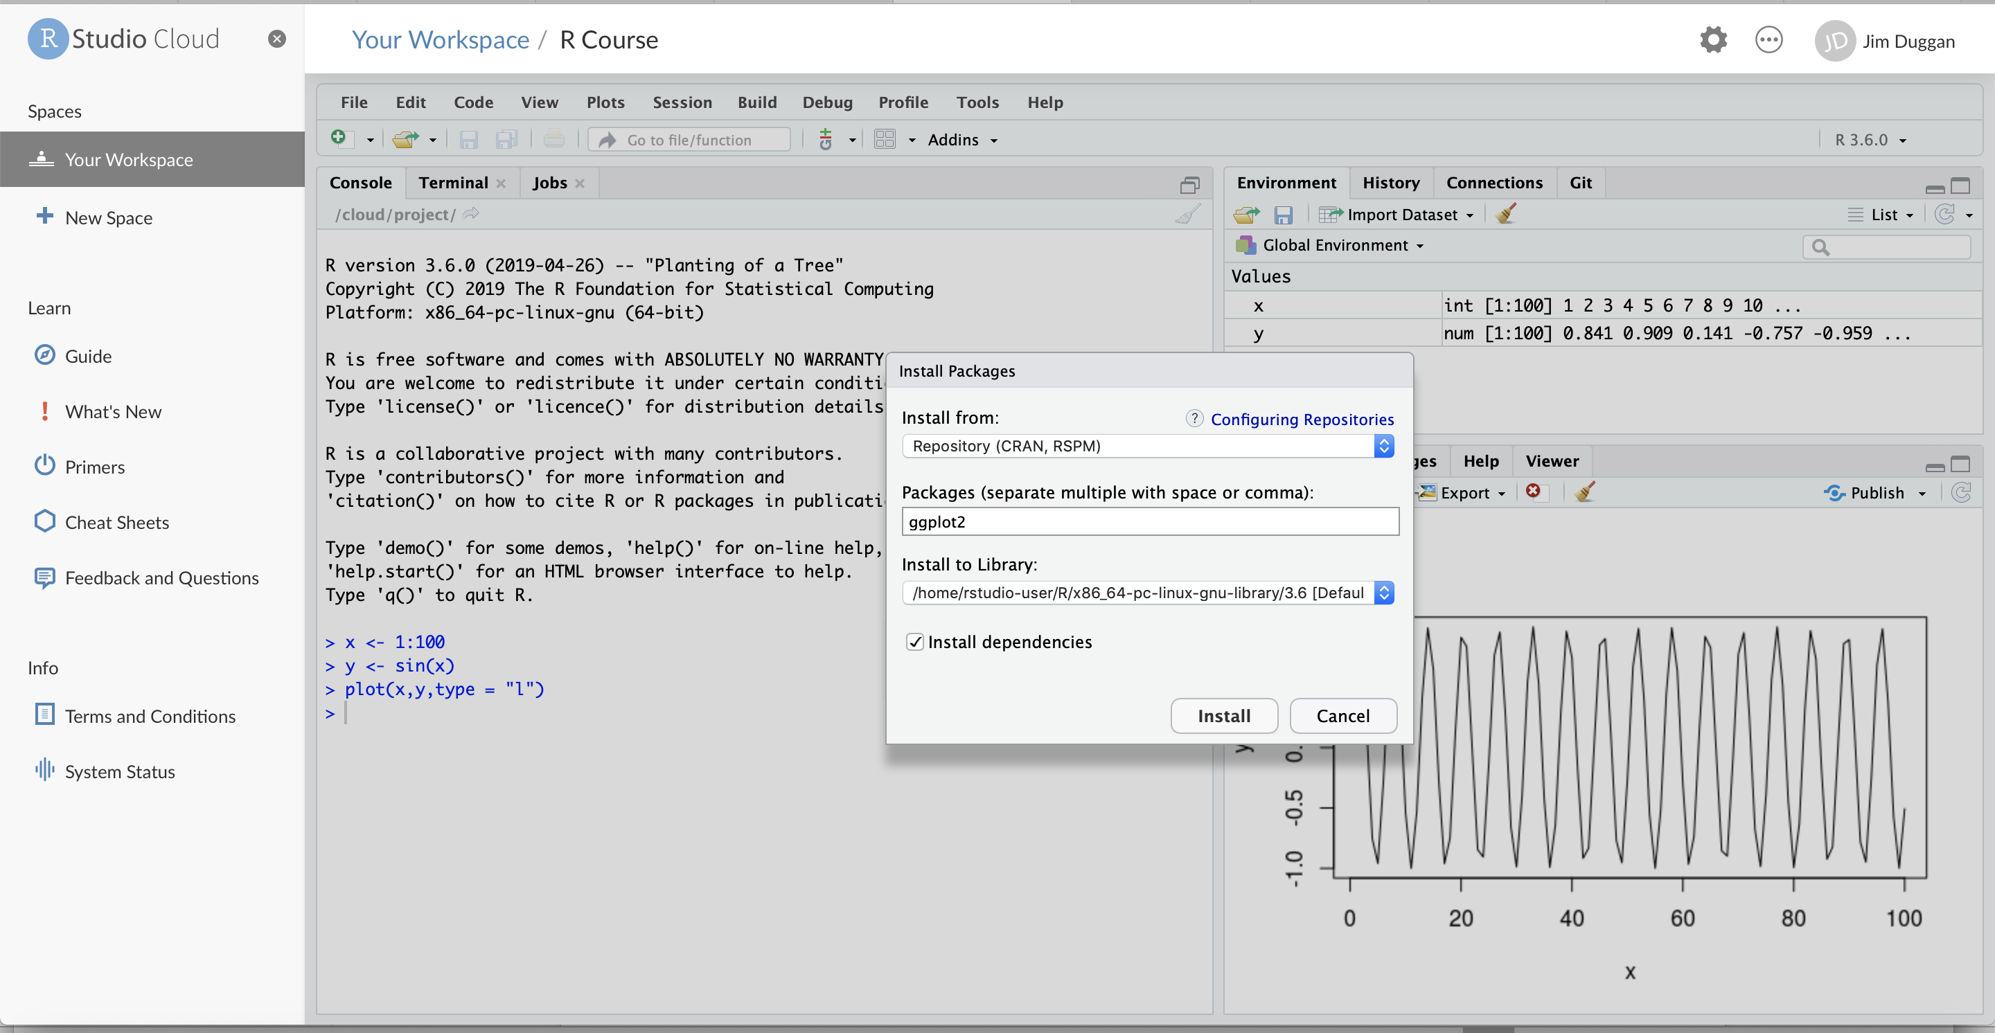
(6) For example, ggplot2

Slide 8
(7) Sample Packages required
Package | Purpose
ggplot2 | Produce graphics for data
dplyr | Analysis of data held in tibbles/data frames
tidyr | Tidy data in order to make it suitable for processing
readxl | Read Excel worksheets into R (as tibbles)

